Slide 1
Edkaagmik Nbiizh Neyaashiinigamiingninwag Edbendaagzijig Trust
Presented by:
Darren Rennie, CPA, CA
Partner
Date: May 14, 2024
December 31, 2023 Audit

Slide 2
Agenda
Management and Trustee Responsibility’s
Auditor Responsibility
Audit Opinion
Financial Results and Highlights

Slide 3
Management and Trustee Responsibility
Operating the Trust, including appointing investment managers
Financial statements
Present and prepare in accordance with PSAS (Canadian Public Sector Accounting Standards)
Design and maintain accounting system and internal controls to
Ensure transactions are authorized
Safeguard assets
Properly maintain financial records
Trustee’s approve the financial statements
Trustee’s appoint the external auditor
Give full and free access to information

Slide 4
Auditor Responsibility (MNP)
MNP is NOT involved in investment decisions, or managing the Trust
MNP’s role is to express an audit opinion on the financial statements
We provide an independent assessment to provide comfort that the Trust’s financial position and performance is being reported correctly and is adhering to the Trust agreement
Follow Canadian GAAS (Generally Accepted Auditing Standards)
Regulatory set of standards that outlines consistency and expectations for best practice in Canadian audits
Comply with ethical standards and properly plan and perform audit
Assess risk areas and internal controls
Examine on a test basis

Slide 5
Auditor Opinions
For December 31, 2023 – MNP provided an ‘unqualified’ or ‘clean’ audit report on the financial statements
In our opinion, the financial statements present fairly, in all material respects, the financial position of Edkaagmik Nbiizh Neyaashiinigamiingninwag Edbendaagzijig Trust as at December 31, 2023 and the results of its operations and accumulated surplus, remeasurement gains and changes in financial position for the year then ended in accordance with Canadian public sector accounting standards

Slide 6
Revenues
Includes all money received or receivable by ENNET
Dividends
Interest income
Realized gain on disposal of investments

Slide 7
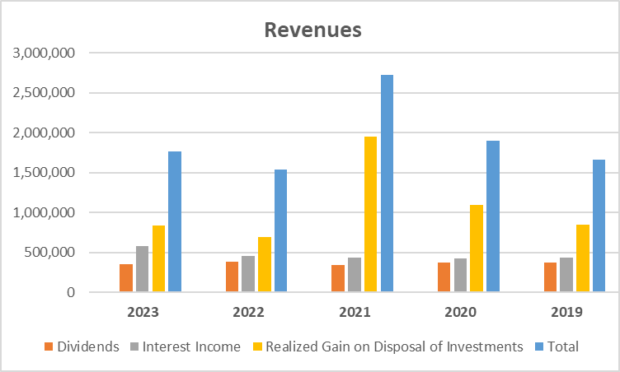
Revenues

Slide 8
Expenditures
All operating costs of ENNET
Professional fees
Office and other
Trustee fees
Investment management fees
Dixon Mitchell Investment Counsel Inc.
Guardian Capital LP
Investment consulting fee
TE Investment Counsel Inc.
Trustee honoraria

Slide 9
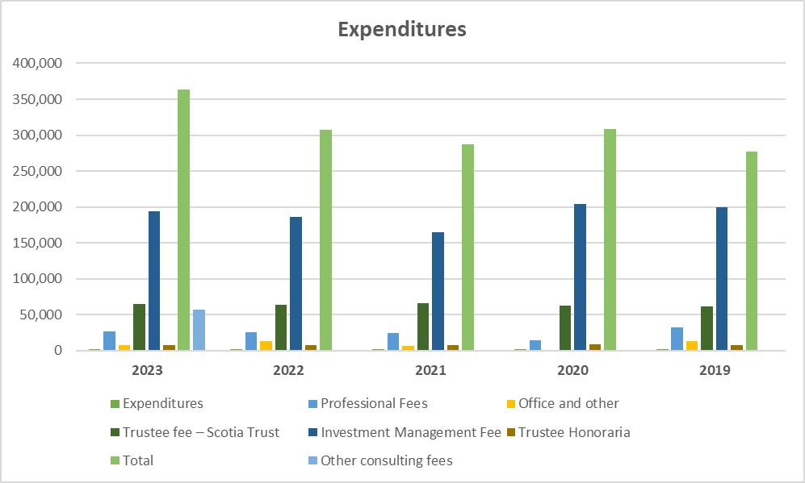
Expenditures

Slide 10
Surplus Allocation
Due to Chippewas of Nawash Unceded First Nation
Under the terms of the Trust Agreement, the Trustees must distribute the surplus income realized by the Trust each year to the Chippewas of Nawash Unceded First Nation prior to the last day of the fiscal year

Slide 11
Surplus Allocation
Due to Chippewas of Nawash Unceded First Nation
 | 2023 | 2022 | 2021 | 2020 | 2019
Surplus | $1,403,263 | $1,225,433 | $2,434,663 | $1,591,395 | $1,380,679
Less: Approved Projects | ($568,985) | ($979,682) | ($638,558) | ($691,486) | ($358,992)
Less: Half of net realized gains | ($416,729) | ($346,413) | ($973,681) | ($546,923) | ($423,110)
Less: prior year deficit | ($100,662) | - | - | - | -
Allocated surplus and payable to Chippewas of Nawash Unceded First Nation | ($316,887) | ($100,662) | $822,424 | $352,986 | $598,577

Slide 12
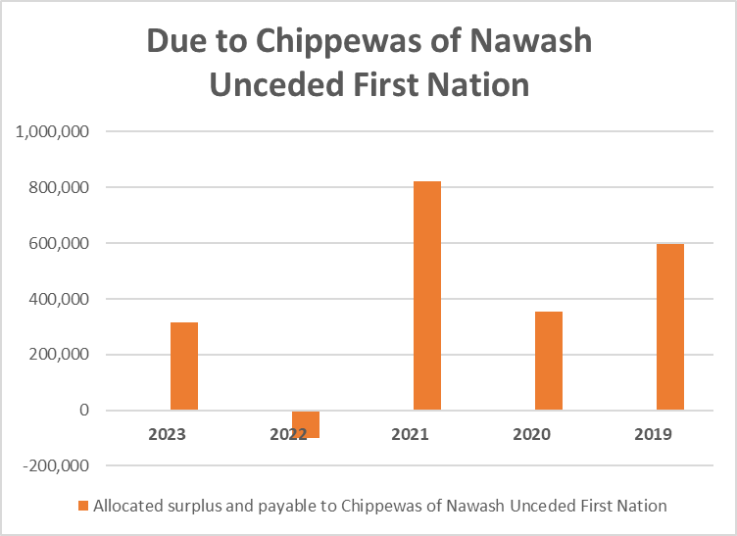
Surplus Allocation

Slide 13
Approved Projects
Approved Projects 2023 | 2023
Community Christmas Voucher Program | 275,000
Culture/Education - Potawatomi Gathering | 34,000
Culture/Education - Three Fires | 43,000
Culture - Pow Wow Vendor Fees (payment to assist 29 members with vendor fees) | 4,000
Economic Development - Finance Department (funding for 22 small businesses) | 109,855
Education - Artist Studio & Community Workspace | 40,000
Education - Musicfest Vancouver Travel Support | 1,250
Education - Watchkeeping Mate Licence | 3,227
Health - Electric Porch Lift | 8,565
Health - Generator | 17,611
Health - Hockey Costs | 3,977
Health - Hockey Fees | 2,000
Health - Personal Greenhouse | 2,000
Health - Reggae Reconciliation Concert | 20,000
Health - Safety Support | 2,500
Health - Yoga Instructor Training | 2,000
Total (2023) | $568,985

Slide 14
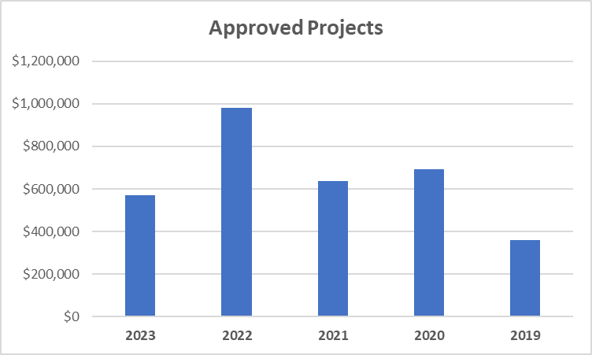
Approved Projects

Slide 15
Assets
Definition - Things that ENNET owns or has owing to ENNET that provide economic benefits
Cash
Investments
Accrued investment income receivable (Accounts Receivable)

Slide 16
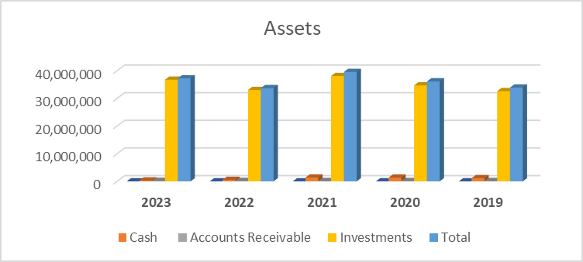

Slide 17
Trust Equity
Definition - Everything that ENNET owns LESS what ENNET owes (unspent wealth)
Accumulated operating surplus
Accumulated remeasurement gains

Slide 18
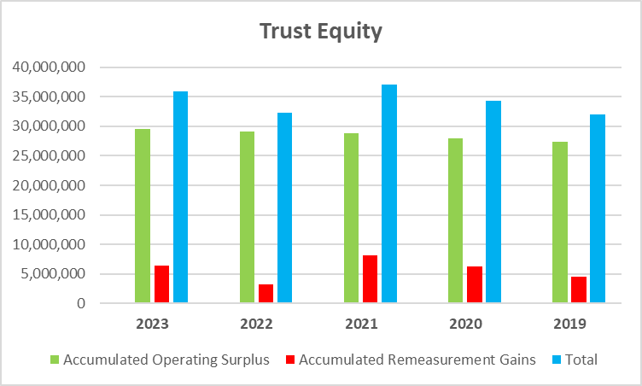
Trust Equity

Slide 19
Questions?
Darren Rennie, CPA, CA
Partner
darren.rennie@mnp.ca
519.772.2980

